Slide 1
Data pre-processing and Discretization
TEAM MEMBERS:
Charishma Gurram – 800960338
Vivekananda Adepu – 800967951
Sai Mounika Pabbathireddy – 800934319
Hanisha Marothu – 800966169
Nikhita Munlagiri – 800960995
Pooja Gajapaga – 800984655

Slide 2
ABSTRACT
With the rapid expansion of e-commerce, more and more products are sold on the Web, and more and more people are buying products on the Web. In order to enhance customer satisfaction and their shopping experiences, it has become a common practice for online merchants to enable their customers to review or to express opinions on the products that they buy.
Explicit online customer reviews on a product are processed in such a way that they are repaired, tokenized, preprocessed, their parts of speech are known and only frequently discussed relevant features in the review set are mined using different algorithms. The reviews which have relevant frequent features are considered for sentiment analysis.
This project implements some initial steps of sentiment analysis so that the end user can use it for further steps.

Slide 3






Slide 4
PROBLEM DEFINITION
The problem is extracting the features from the reviews which are explicit, is a difficult task because we need to disambiguate the sense of the reviews and then performing sentiment analysis. The main challenge here is to recognizing the false reviews which doesn’t mean the same as they look when we read. A human being can read and understand whether it is a false review or a genuine review but it is not same with automated machine or tool. More over after finding the state of review then we go for the repetition of the review i.e., how many times it is repeated and finding which product is trending. So this will be the problem we need to look in for.

Slide 5
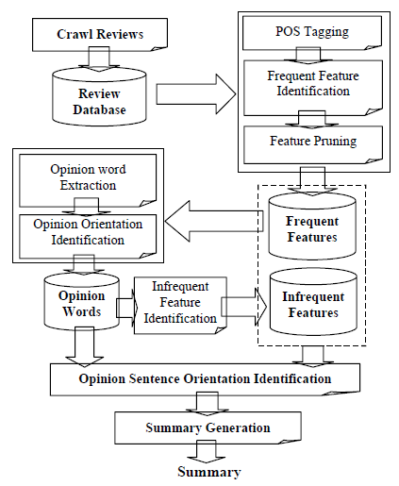
Existing system

Slide 6
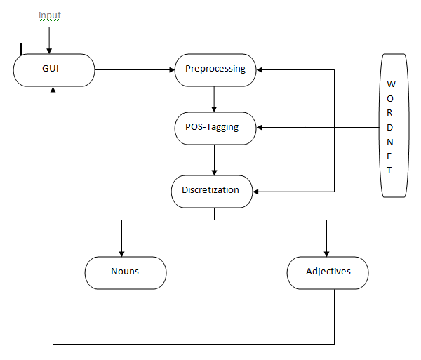

PROPOSED THEORY

Slide 7
Requirements -Functional
Gather reviews about the product from online websites
Select a set of product features to rate on.
Determine the ratings for the selected features based on the sentiment of the sentence in which it appears.
Summarize the ratings for the features as the total number of positive and negative points for each of the review.
Draw a graph based on the summarized ratings and depicting the trend of a particular feature.

Slide 8
Requirements - Non-Functional
Maintainability: The software needs to be easily maintained. There must be proper documentation of the entire software in such a way that it is easily readable by a new developer. In Case of any issues the development/maintenance team should be able to fix the problem quickly and push it to production and ensure that there is very less downtime.
Usability: The application should be very easy to understand and use. Novice users who are new to technology should be easily able to figure out what to do in the application to accomplish their tasks.
Availability: The application should be always online providing the latest status of the reviews and delivering the output in a timely manner.
Scalability: This application can be scaled if the user interest grows. The application should be able to handle large number of requests from users and at the same update users quickly.

Slide 9


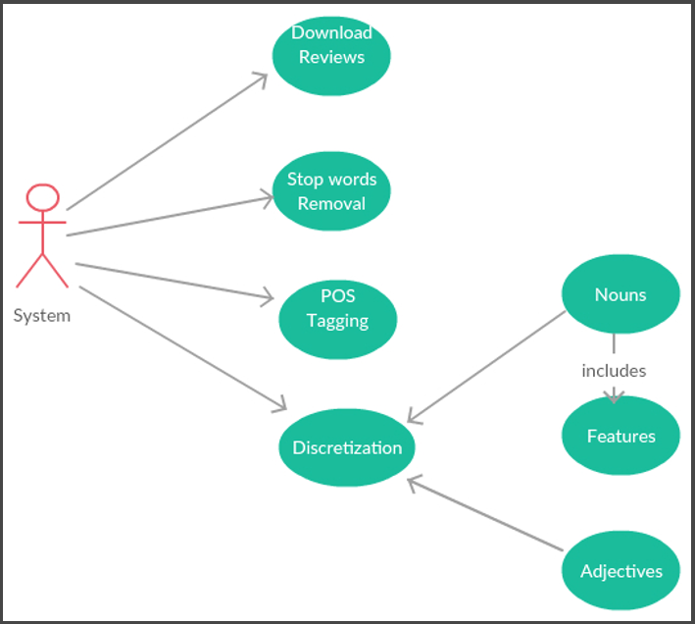


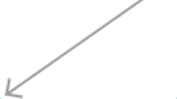
USE-CASE dIAGRAM
User

Slide 10
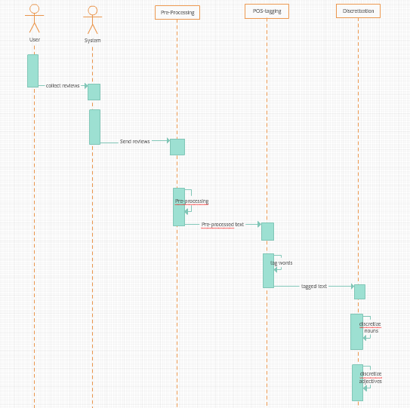
Sequence Diagram

Slide 11
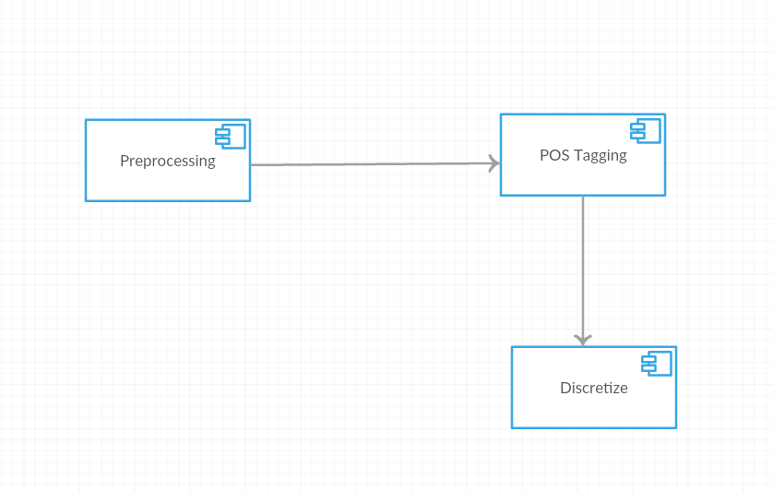
Component Diagram

Slide 12
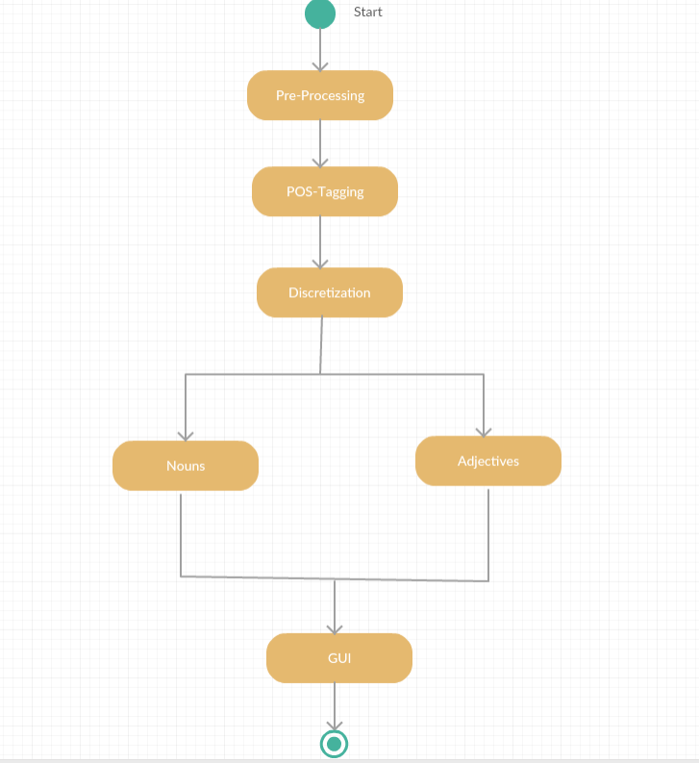
Activity Diagram:

Slide 13
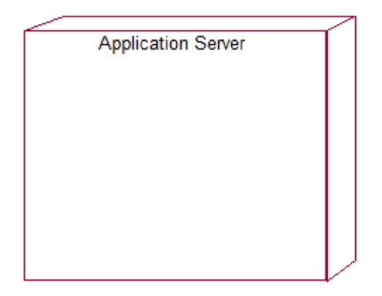
Deployment Diagram:
JETTY

Slide 14
IMPLEMENTATION:
STEP-1:
Pre-Processing:
All the stop words present in a given input text which consists of selected product reviews are removed.
The text that contains all the selected product reviews is given as input to the program.
The program processes the text and then splits each word of the text.
Each word of the text is compared with the set of stop words.
If the word that is present in the text is a stop word, then it is eliminated.
Since all the stop words are removed the result has no stop words.

Slide 15
Step-2: Parts Of Speech Tagging:
Each word in the text is tagged with the respective parts of speech.
The output text from the step-1 is given to the step-2 for parts of speech tagging.
In this step the Stanford-postagger.jar is used to tag the parts of speech of any given text.
The Stanford-POS tagger hence tags the content of the text containing the reviews.
The output is then written to a text .

Slide 16
Step-3: Discretization:
The adjectives and nouns that are present in the tagged are separated and stored in two different s.
The output from step-2 is given to step-3 for discretization.
The Nouns and Adjectives that are present in the tagged text are separated in this step.
The program checks each element of the text and then retrieves the nouns in the text.
The Nouns that are retrieved are shown in a textbox.
The same applies for adjectives as well.

Slide 17
CONCLUSION
Explicit online customer reviews on a product are processed in such a way that they are repaired, tokenized, preprocessed, their parts of speech are known and only frequently discussed relevant features in the review set are mined using different algorithms. The reviews which have relevant frequent features are considered for sentiment analysis. Sentiments are extracted from the reviews using Senti-WordNet. Based on it, Trend analysis of the product is extracted.
In future, more work is needed on further refining techniques mentioned in this project and to deal with the outstanding problems like subjectivity classification, word sentiment classification based on machine learning techniques and opinion extraction problem. A variety of steps can be taken to expand this work further by creation of categories for sentiment word senses, where the Senti-WordNET is mined for categories of word senses which are particular to products and make the sentiment analysis much easier and reduce the manual work done.

Slide 18
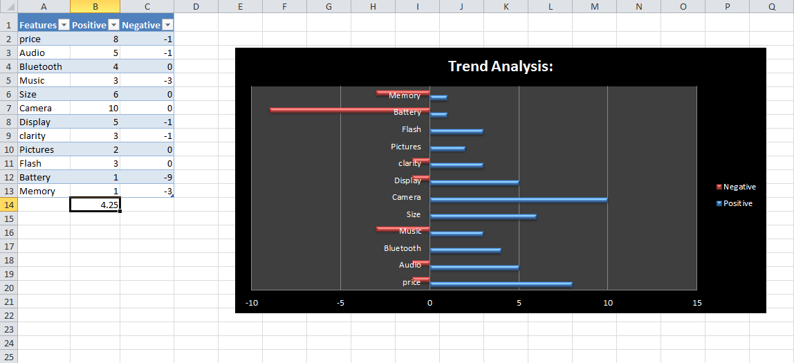

Slide 19
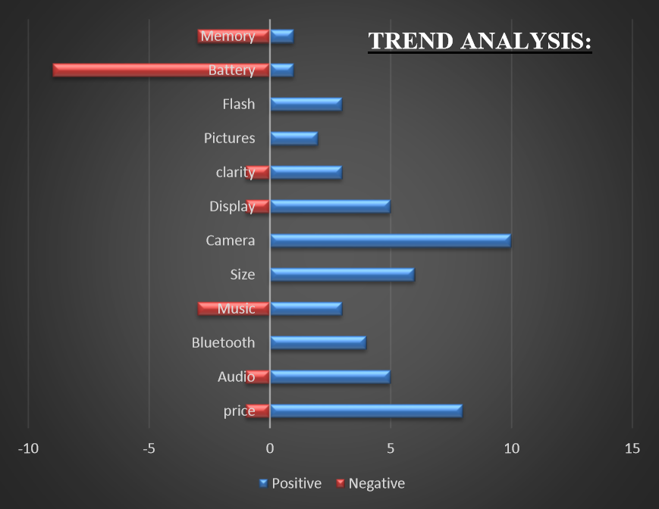

Slide 20
REFERENCES:
Aspect and Entity Extraction for Opinion Mining-Lei Zhang and Bing Liu.
A survey on sentiment detection of reviews-Huifeng Tang, Songbo Tan, Xueqi cheng.
Stop Word List: -- http://xpo6.com/list-of-english-stop-words/.
SentiWordNET source: -- http://sentiwordnet.isti.cnr.it/
Obtaining feature and sentiment based linked instance RDF data from unstructured reviews using ontology-based machine learning --D. Teja Santosh, B. Vishnu Vardhan.
Opinion Mining of Online Product Reviews from Traditional LDA Topic Clusters using Feature Ontology Tree and Sentiwordnet- http://www.mecs-press.org/ijeme/ijeme-v6-n6/IJEME-V6-N6-4.pdf - D. Teja Santosh, A. Vivekananda
http://nlp.stanford.edu/software/tagger.shtml
http://nlp.stanford.edu/software/pos-tagger-faq.shtml#b

